Slide 1
Conventional Encryption Principles
An encryption scheme has five ingredients:
  Plaintext
  Encryption algorithm
  Secret Key
  Ciphertext
  Decryption algorithm
Security depends on the secrecy of the key, not the secrecy of the algorithm

Slide 2
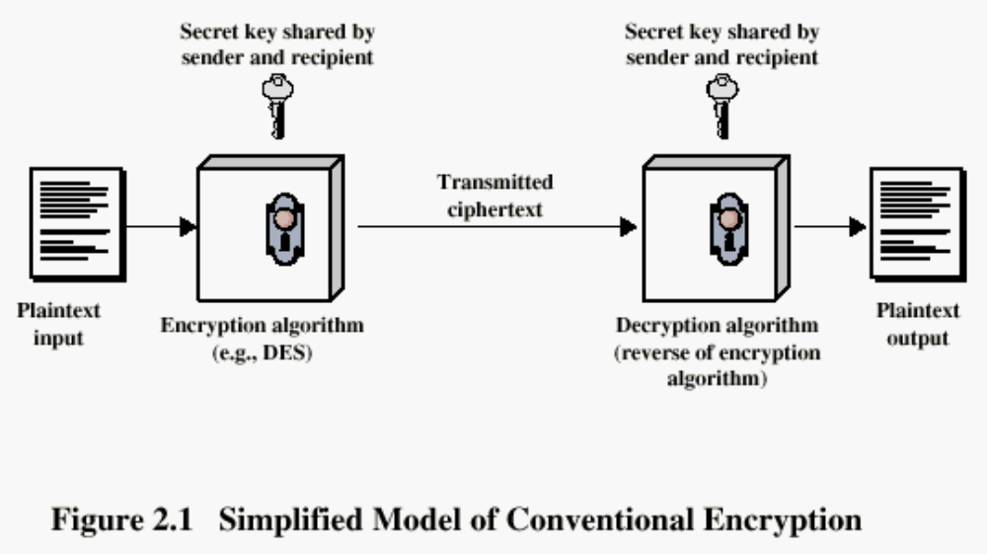
Conventional Encryption Principles

Slide 3
The 3 CRYPTs
Cryptology= Cryptography + Cryptanalysis
Cryptography= Deals with design of algorithms for encryption and decryption, intended to ensure the secrecy and/or authenticity of messages.
Cryptanalysis= Deals with breaking of a cipher (algorithm) to recover information, or forging encrypted information that will be accepted as authentic.

Slide 4
Cryptography
Classified along three independent dimensions:
  The type of operations used for transforming plaintext to ciphertext
  The number of keys used
    symmetric (single key)
    asymmetric (two-keys, or public-key encryption)
  The way in which the plaintext is processed

Slide 5
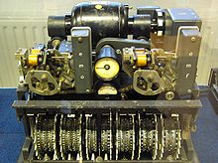
German Lorenz cipher machine, used in World War II to encrypt very-high-level general staff messages

Slide 6
Cryptanalysis
The process of attempting to discover the plaintext or key is known as cryptanalysis.
The strategy used by the cryptanalyst depends on nature of the encryption scheme and the information available to the cryptanalyst.

Slide 7
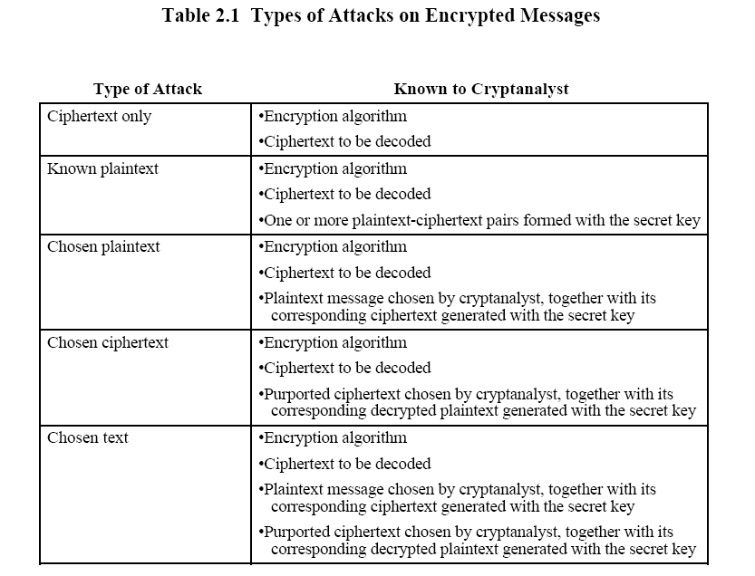

Slide 8
Average time required for exhaustive key search
Key Size (bits) | Number of Alternative Keys | Time required at 106 Decryption/µs
32 | 232 = 4.3 x 109 | 2.15 milliseconds
56 | 256 = 7.2 x 1016 | 10 hours
128 | 2128 = 3.4 x 1038 | 5.4 x 1018 years
168 | 2168 = 3.7 x 1050 | 5.9 x 1030 years

Slide 9
Feistel Cipher Structure
Virtually all conventional block encryption algorithms, including DES have a structure first described by Horst Feistel of IBM in 1973
The realization of a Fesitel Network depends on the choice of the following parameters and design features (see next slide):

Slide 10
Feistel Cipher Structure
Block size: larger block sizes mean greater security
Key Size: larger key size means greater security
Number of rounds: multiple rounds offer increasing security
Subkey generation algorithm: greater complexity will lead to greater difficulty of cryptanalysis.
Fast software encryption/decryption: the speed of execution of the algorithm becomes a concern

Slide 11
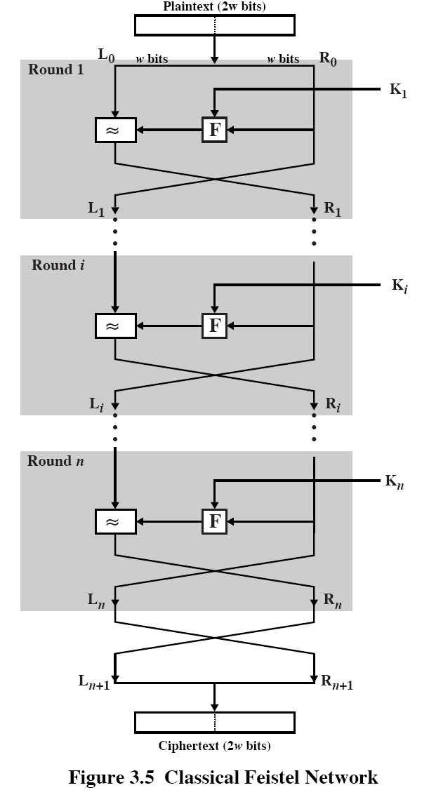

Slide 12
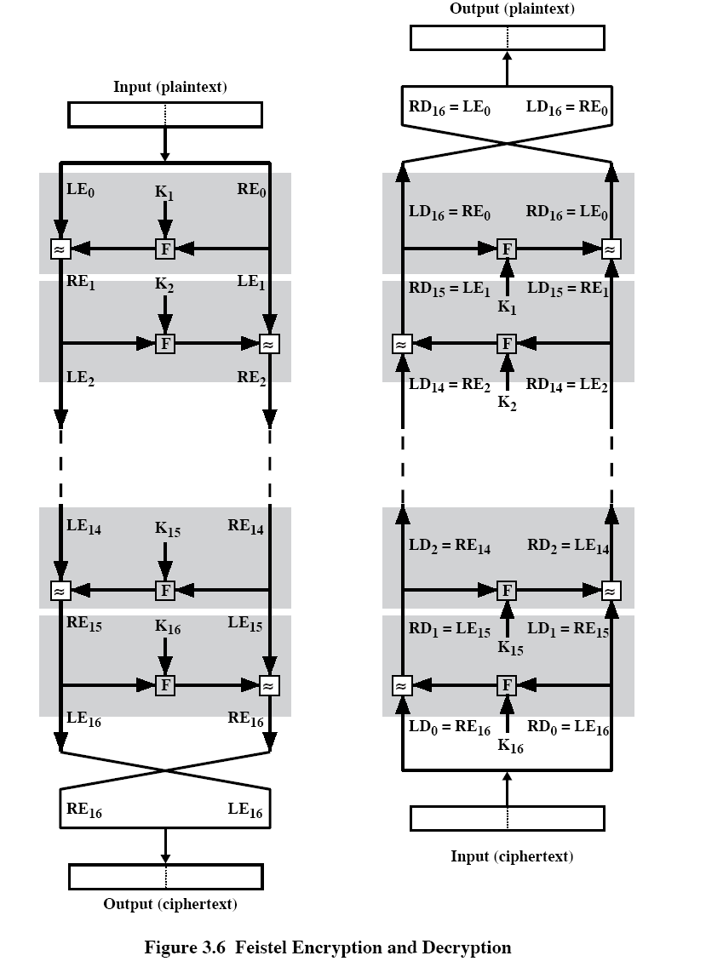

Slide 13
Simplified DES(S-DES)

Slide 14
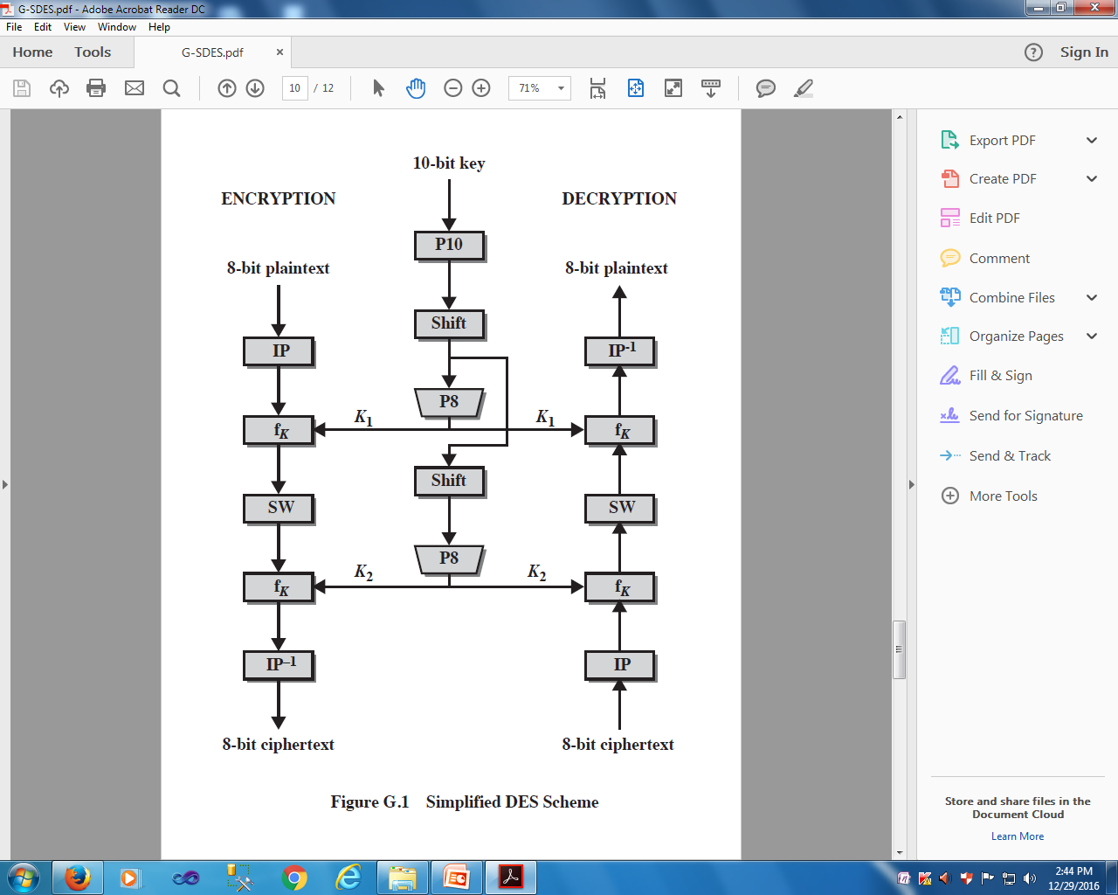

Slide 15
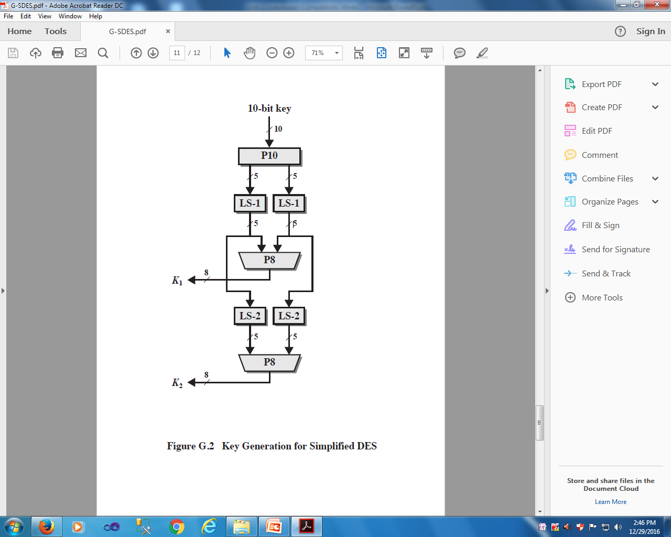

Slide 16
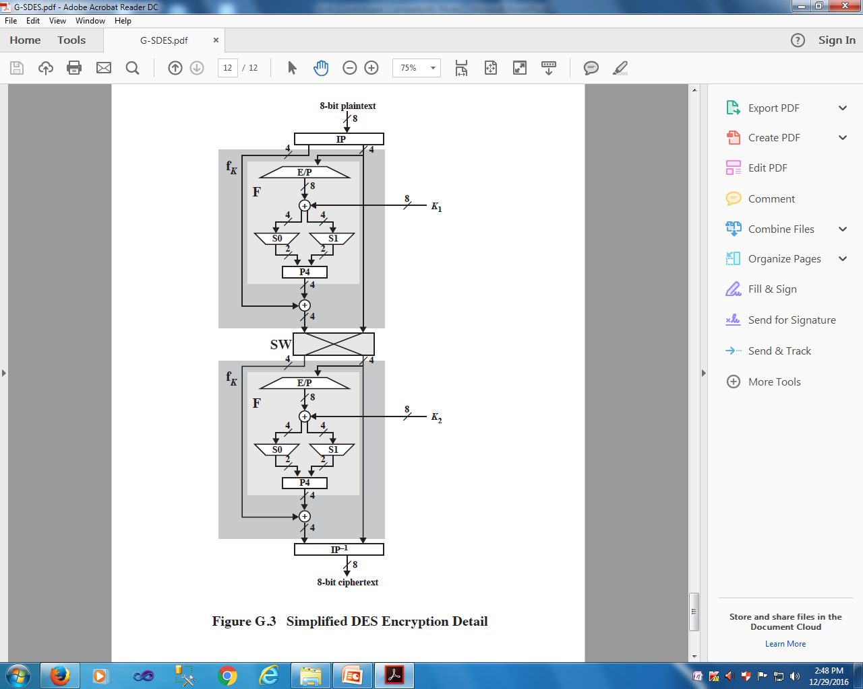

Slide 17
Conventional Encryption Algorithms
Data Encryption Standard (DES)
  The most widely used encryption scheme
  The algorithm is reffered to the Data Encryption Algorithm (DEA)
  DES is a block cipher
  The plaintext is processed in 64-bit blocks
  The key is 56-bits in length

Slide 18
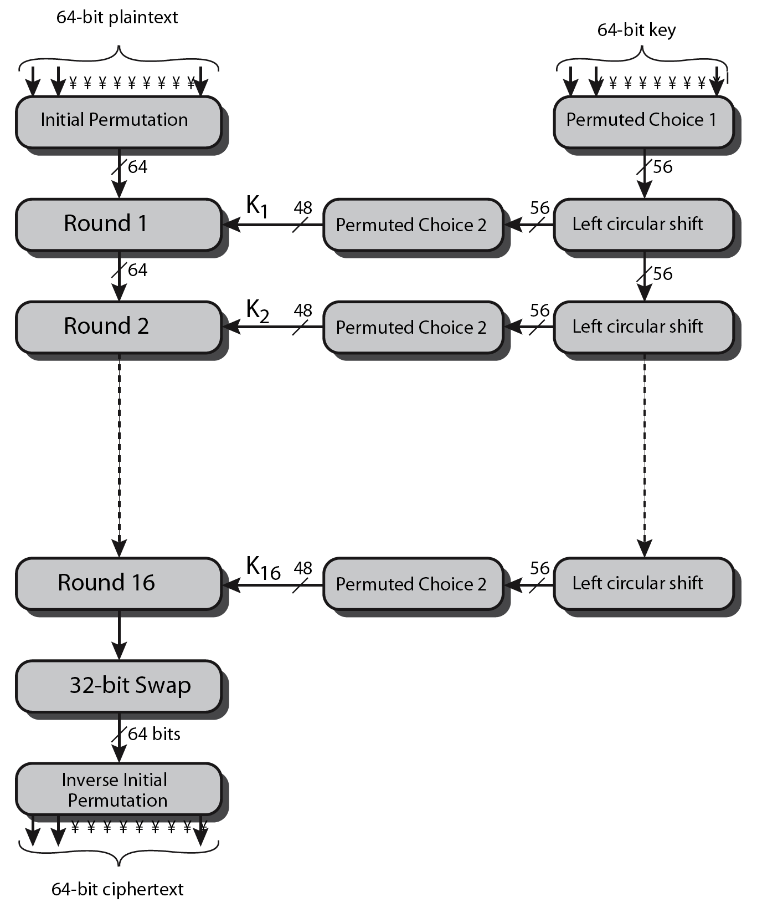
DES Encryption Overview
Notes:
The overall scheme for DES encryption is illustrated in Stallings Figure3.4, which takes as input 64-bits of data and of key.
The left side shows the basic process for enciphering a 64-bit data block which consists of:
- an initial permutation (IP) which shuffles the 64-bit input block
- 16 rounds of a complex key dependent round function involving substitutions & permutations
- a final permutation, being the inverse of IP
The right side shows the handling of the 56-bit key and consists of:
- an initial permutation of the key (PC1) which selects 56-bits out of the 64-bits input, in two 28-bit halves
- 16 stages to generate the 48-bit subkeys using a left circular shift and a permutation of the two 28-bit halves

Slide 19
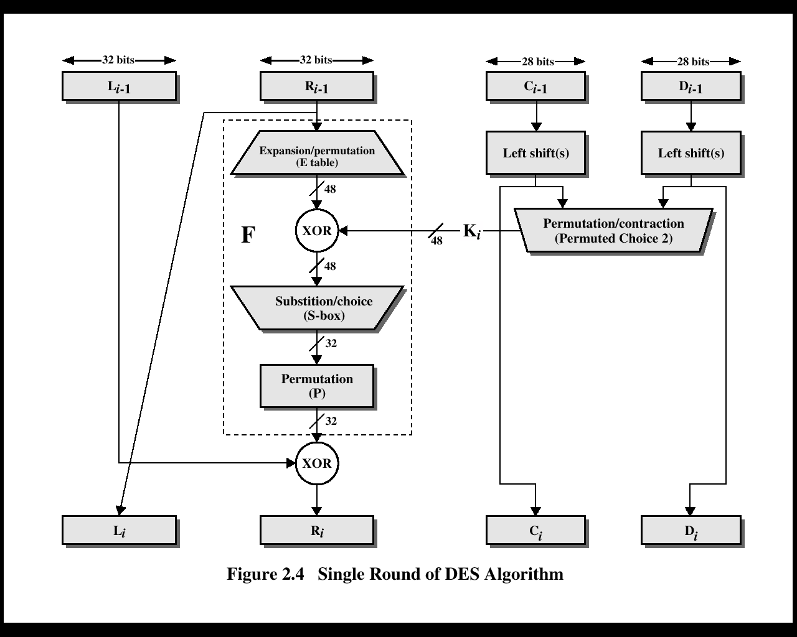

Slide 20
DES Round Structure
uses two 32-bit L & R halves
as for any Feistel cipher can describe as:
  L_{i} = R_{i–1}
  R_{i} = L_{i–1} ⊕ F(R_{i–1}, K_{i})
F takes 32-bit R half and 48-bit subkey:
  expands R to 48-bits using perm E
  adds to subkey using XOR
  passes through 8 S-boxes to get 32-bit result
  finally permutes using 32-bit perm P
Notes:
Detail here the internal structure of the DES round function F, which takes R half & subkey, and processes them through E, add subkey, S & P.
This follows the classic structure for a feistel cipher.
Note that the s-boxes provide the “confusion” of data and key values, whilst the permutation P then spreads this as widely as possible, so each S-box output affects as many S-box inputs in the next round as possible, giving “diffusion”.

Slide 21
Encryption (IP, IP⁻¹)
IP
IP-1
Bit | 0 | 1 | 2 | 3 | 4 | 5 | 6 | 7
1 | 58 | 50 | 42 | 34 | 26 | 18 | 10 | 2
9 | 60 | 52 | 44 | 36 | 28 | 20 | 12 | 4
17 | 62 | 54 | 46 | 38 | 30 | 22 | 14 | 6
25 | 64 | 56 | 48 | 40 | 32 | 24 | 16 | 8
33 | 57 | 49 | 41 | 33 | 25 | 17 | 9 | 1
41 | 59 | 51 | 43 | 35 | 27 | 19 | 11 | 3
49 | 61 | 53 | 45 | 37 | 29 | 21 | 13 | 5
57 | 63 | 55 | 47 | 39 | 31 | 23 | 15 | 7
Bit | 0 | 1 | 2 | 3 | 4 | 5 | 6 | 7
1 | 40 | 8 | 48 | 16 | 56 | 24 | 64 | 32
9 | 39 | 7 | 47 | 15 | 55 | 23 | 63 | 31
17 | 38 | 6 | 46 | 14 | 54 | 22 | 62 | 30
25 | 37 | 5 | 45 | 13 | 53 | 21 | 61 | 29
33 | 36 | 4 | 44 | 12 | 52 | 20 | 60 | 28
41 | 35 | 3 | 43 | 11 | 51 | 19 | 59 | 27
49 | 34 | 2 | 42 | 10 | 50 | 18 | 58 | 26
57 | 33 | 1 | 41 | 9 | 49 | 17 | 57 | 25
Note: IP(IP-1) = IP-1(IP) = I

Slide 22

Expansion /Permutation box
Since right input is 32-bit and round key is a 48-bit, we first need to expand right input to 48 bits.
Permutation logic is graphically depicted in the following illustration −

Slide 23
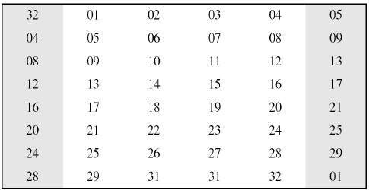
The graphically depicted permutation logic is generally described as table in DES specification illustrated as shown −

Slide 24
Encryption (Round) (cont.)
E
P
32 | 1 | 2 | 3 | 4 | 5
4 | 5 | 6 | 7 | 8 | 9
8 | 9 | 10 | 11 | 12 | 13
12 | 13 | 14 | 45 | 16 | 17
16 | 17 | 18 | 19 | 20 | 21
20 | 21 | 22 | 23 | 24 | 25
24 | 25 | 26 | 27 | 28 | 29
28 | 29 | 30 | 31 | 32 | 1
16 | 7 | 20 | 21 | 29 | 12 | 28 | 17
1 | 15 | 23 | 26 | 5 | 18 | 31 | 10
2 | 8 | 24 | 14 | 32 | 27 | 3 | 9
9 | 13 | 30 | 6 | 22 | 11 | 4 | 25
Expansion
Expansion

Slide 25
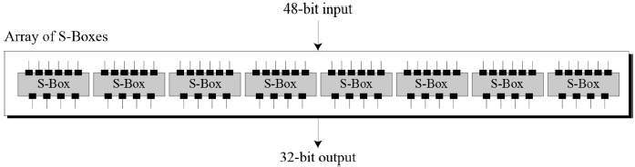
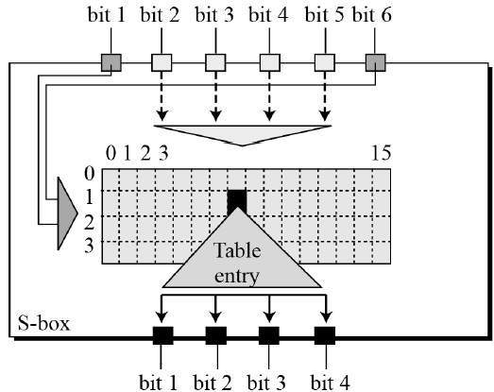

Slide 26
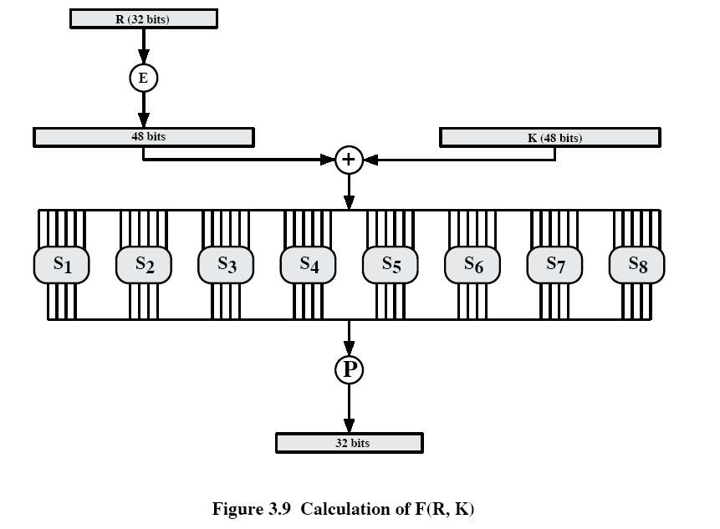

Slide 27
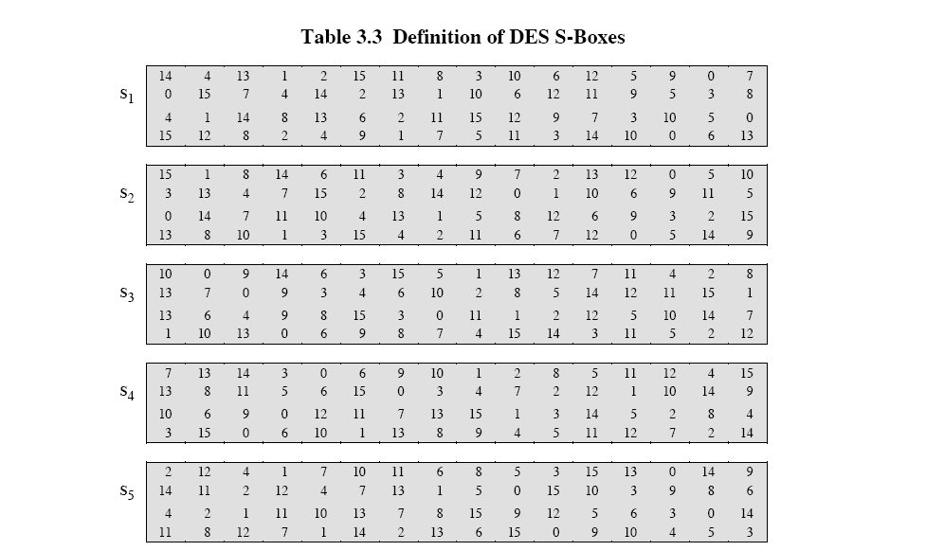
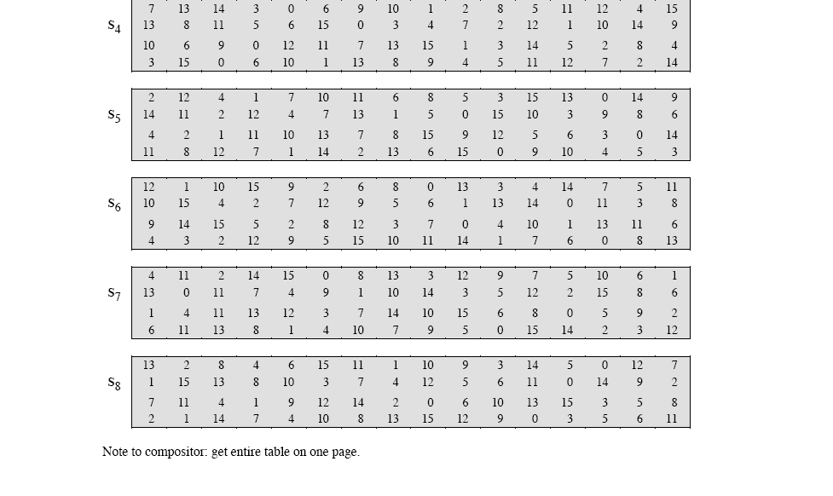
Encryption (Round) (cont.)
S-box
[1]

Slide 29
DES Key Schedule
forms subkeys used in each round
  initial permutation of the key (PC1) which selects 56-bits in two 28-bit halves
  16 stages consisting of:
    rotating each half separately either 1 or 2 places depending on the key rotation schedule K
    selecting 24-bits from each half & permuting them by PC2 for use in round function F
Concerns about:
  The algorithm and the key length (56-bits)
Notes:
The DES Key Schedule generates the subkeys needed for each data encryption round. The 64-bit key input is first processed by Permuted Choice One (Stallings Table 3.4b). The resulting 56-bit key is then treated as two 28-bit quantities C & D. In each round, these are separately processed throgh a circular left shift (rotation) of 1 or 2bits as shown in Stallings Table 3.4d. These shifted values serve as input to the next round of the key schedule. They also serve as input to Permuted Choice Two (Stallings Table 3.4c), which produces a 48-bit output that serves as input to the round function F.
The 56 bit key size comes from security considerations as we know now. It was big enough so that an exhaustive key search was about as hard as the best direct attack (a form of differential cryptanalysis called a T-attack, known by the IBM & NSA researchers), but no bigger. The extra 8 bits were then used as parity (error detecting) bits, which makes sense given the original design use for hardware communications links. However we hit an incompatibility with simple s/w implementations since the top bit in each byte is 0 (since ASCII only uses 7 bits), but the DES key schedule throws away the bottom bit! A good implementation needs to be cleverer!

Slide 30
DES Analysis
The DES satisfies both the desired properties of block cipher. These two properties make cipher very strong.
Avalanche effect − A small change in plaintext results in the very grate change in the ciphertext.
Completeness − Each bit of ciphertext depends on many bits of plaintext.
During the last few years, cryptanalysis have found some weaknesses in DES when key selected are weak keys. These keys shall be avoided.
DES has proved to be a very well designed block cipher. There have been no significant cryptanalytic attacks on DES other than exhaustive key search.

Slide 31
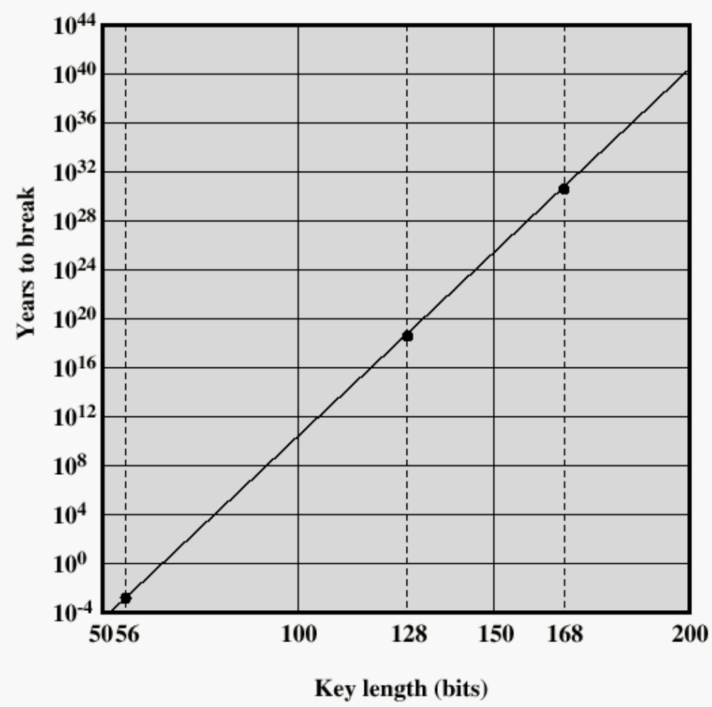
Time to break a code (10⁶ decryptions/µs)

Slide 32
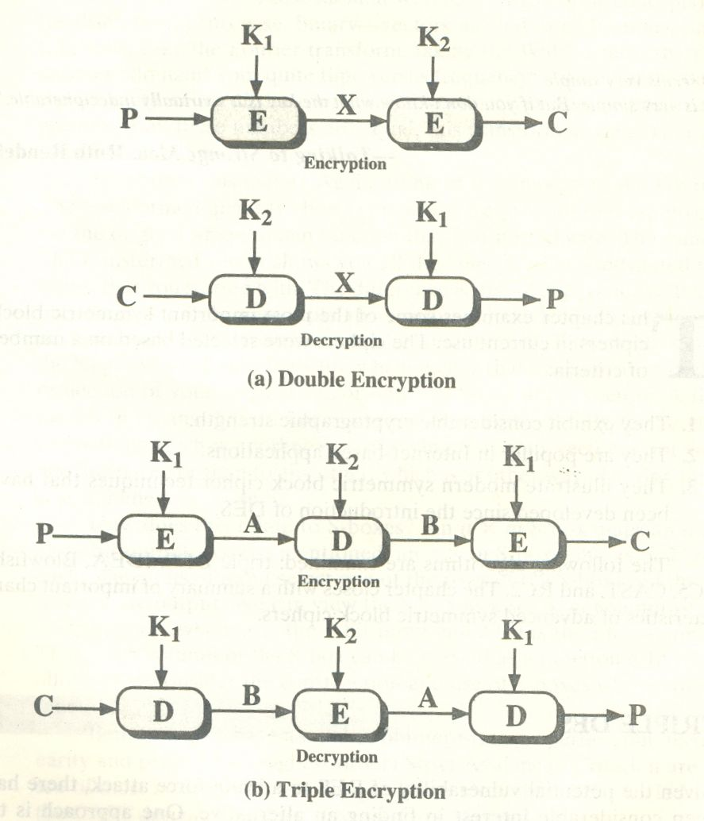
Double DES and Triple DES
Double DES (or)
Double DEA
Triple DES (or)
Triple DEA
With two keys

Slide 33
Triple DEA with 3 keys
Use three keys and three executions of the DES algorithm (encrypt-decrypt-encrypt)
    C = ciphertext
    P = Plaintext
    EK[X] = encryption of X using key K
    DK[Y] = decryption of Y using key K
Effective key length of 168 bits
C = EK3[DK2[EK1[P]]]

Slide 34
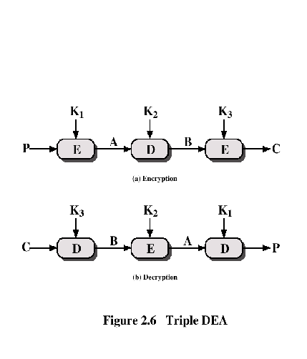
Triple DEA

Slide 35
Advanced Encryption Standard (AES) Origins
clear a replacement for DES was needed
  have theoretical attacks that can break it
  have demonstrated exhaustive key search attacks
can use Triple-DES – but slow, has small blocks
US NIST issued call for ciphers in 1997
15 candidates accepted in Jun 98
5 were shortlisted in Aug-99
Rijndael was selected as the AES in Oct-2000
issued as FIPS PUB 197 standard in Nov-2001
Notes:
The Advanced Encryption Standard (AES) was published by NIST (National Institute of Standards and Technology) in 2001. AES is a symmetric block cipher that is intended to replace DES as the approved standard for a wide range of applications. The AES cipher (& other candidates) form the latest generation of block ciphers, and now we see a significant increase in the block size - from the old standard of 64-bits up to 128-bits; and keys from 128 to 256-bits. In part this has been driven by the public demonstrations of exhaustive key searches of DES. Whilst triple-DES is regarded as secure and well understood, it is slow, especially in s/w. In a first round of evaluation, 15 proposed algorithms were accepted. A second round narrowed the field to 5 algorithms. NIST completed its evaluation process and published a final standard (FIPS PUB 197) in November of 2001. NIST selected Rijndael as the proposed AES algorithm. The two researchers who developed and submitted Rijndael for the AES are both cryptographers from Belgium: Dr. Joan Daemen and Dr.Vincent Rijmen.

Slide 36
The AES Cipher - Rijndael
designed by Rijmen-Daemen in Belgium
Key: 128/192/256 bit keys,
Plaintext: 128 bit data
an iterative rather than Feistel cipher
  processes data as block of 4 columns of 4 bytes
  operates on entire data block in every round
designed to have:
  resistance against known attacks
  speed and code compactness on many CPUs
  ^{design simplicity}
Notes:
The Rijndael proposal for AES defined a cipher in which the block length and the key length can be independently specified to be 128,192,or 256 bits. The AES specification uses the same three key size alternatives but limits the block length to 128 bits. Rijndael is an academic submission, based on the earlier Square cipher, from Belgium academics Dr Joan Daemen and Dr Vincent Rijmen. It is an iterative cipher (operates on entire data block in every round) rather than feistel (operate on halves at a time), and was designed to have characteristics of: Resistance against all known attacks, Speed and code compactness on a wide range of platforms, & Design simplicity.

Slide 37
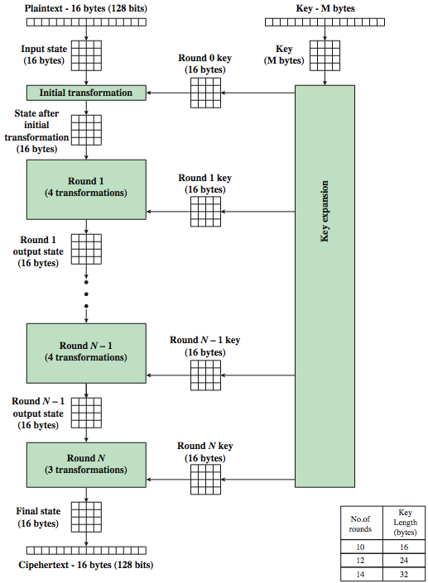
AES Structure
data block of 4 columns of 4 bytes is state
key is expanded to array of words
has 9/11/13 rounds in which state undergoes:
  byte substitution (1 S-box used on every byte)
  shift rows (permute bytes between groups/columns)
  mix columns (subs using matrix multiply of groups)
  add round key (XOR state with key material)
  view as alternating XOR key & scramble data bytes
Notes:
The input to the AES encryption and decryption algorithms is a single 128-bit block, depicted in FIPS PUB 197, as a square matrix of bytes .This block is copied into the State array, which is modified at each stage of encryption or decryption. After the final stage, State is copied to an output.
The key is expanded into 44/52/60 lots of 32-bit words (see later), with 4 used in each round. Note that the ordering of bytes within a matrix is by column. So, for example, the first four bytes of a 128-bit plaintext input to the encryption cipher occupy the first column of the in matrix, the second four bytes occupy the second column, and so on. Similarly, the first four bytes of the expanded key, which form a word, occupy the first column of the w matrix.
The data computation then consists of an “add round key” step, then 9/11/13 rounds with all 4 steps, and a final 10th/12th/14th step of byte subs + mix cols + add round key. This can be viewed as alternating XOR key & scramble data bytes operations. All of the steps are easily reversed, and can be efficiently implemented using XOR’s & table lookups.

Slide 38
AES Encryption Process
Notes:
Stallings Figure 5.1 shows the overall encryption process in AES.

Slide 39

AES Structure
Notes:
Stallings Figure 5.3 shows the structure of AES in more detail. The cipher consists of N rounds, where the number of rounds depends on the key length: 10 rounds for a 16-byte key; 12 rounds for a 24-byte key; and 14 rounds for a 32-byte key. The first N – 1 rounds consist of four distinct transformation functions: SubBytes, ShiftRows, MixColumns, and AddRoundKey, which are described subsequently. The final round contains only 3 transformation, and there is a initial single transformation (AddRoundKey) before the first round, which can be considered Round 0. Each transformation takes one or more 4 x 4 matrices as input and produces a 4 x 4 matrix as output. Figure 5.1 shows that the output of each round is a 4 x 4 matrix, with the output of the final round being the ciphertext. Also, the key expansion function generates N + 1 round keys, each of which is a distinct 4 x 4 matrix. Each round key serve as one of the inputs to the AddRoundKey transformation in each round.

Slide 40
Some Comments on AES
an iterative rather than Feistel cipher
key expanded into array of 32-bit words
  four words form round key in each round
4 different stages are used as shown
has a simple structure
only AddRoundKey uses key
AddRoundKey a form of Vernam cipher
each stage is easily reversible
decryption uses keys in reverse order
decryption does recover plaintext
final round has only 3 stages
Notes:
Before delving into details, can make several comments about the overall AES structure. See text for details.

Slide 41
Substitute Bytes
a simple substitution of each byte
uses one table of 16x16 bytes containing a permutation of all 256 8-bit values
each byte of state is replaced by byte indexed by row (left 4-bits) & column (right 4-bits)
  eg. byte {95} is replaced by byte in row 9 column 5
  ^{which has value {2A}}
S-box constructed using defined transformation of values
designed to be resistant to all known attacks
Notes:
We now turn to a discussion of each of the four transformations used in AES. For each stage, we mention the forward (encryption) algorithm, the inverse (decryption) algorithm, and the rationale for the design of that stage.
The Substitute bytes stage uses an S-box to perform a byte-by-byte substitution of the block. There is a single 8-bit wide S-box used on every byte. This S-box is a permutation of all 256 8-bit values, constructed using a transformation which treats the values as polynomials in GF(2⁸) – however it is fixed, so really only need to know the table when implementing. Decryption requires the inverse of the table. These tables are given in Stallings Table 5.2.
The table was designed to be resistant to known cryptanalytic attacks. Specifically, the Rijndael developers sought a design that has a low correlation between input bits and output bits, with the property that the output cannot be described as a simple mathematical function of the input, with no fixed points and no “opposite fixed points”.

Slide 42
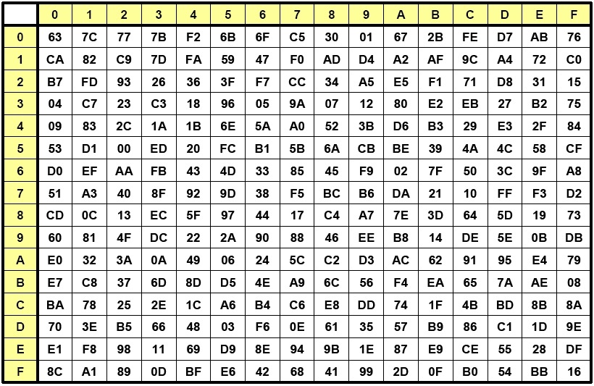

Slide 43


Substitute Bytes
Substitute Bytes Example
Notes:
As this diagram from Stallings Fig 5.5a shows, the Byte Substitution operates on each byte of state independently, with the input byte used to index a row/col in the table to retrieve the substituted value.

Slide 44
Shift Rows
a circular byte shift in each each
  ^{1st row is unchanged}
  2nd row does 1 byte circular shift to left
  3rd row does 2 byte circular shift to left
  4th row does 3 byte circular shift to left
decrypt inverts using shifts to right
since state is processed by columns, this step permutes bytes between the columns
Notes:
The ShiftRows stage provides a simple “permutation” of the data, whereas the other steps involve substitutions. Further, since the state is treated as a block of columns, it is this step which provides for diffusion of values between columns. It performs a circular rotate on each row of 0, 1, 2 & 3 places for respective rows. When decrypting it performs the circular shifts in the opposite direction for each row. This row shift moves an individual byte from one column to another, which is a linear distance of a multiple of 4 bytes, and ensures that the 4 bytes of one column are spread out to four different columns.

Slide 45


Shift Rows
Notes:
Stalling Figure 5.7a illustrates the Shift Rows permutation. Then show an example of ShiftRows from the text.

Slide 46


Mix Columns
each column is processed separately
each byte is replaced by a value dependent on all 4 bytes in the column
Notes:
The forward mix column transformation, called MixColumns, operates on each column individually. Each byte of a column is mapped into a new value that is a function of all four bytes in that column. It is a substitution that makes use of arithmetic over GF(2^8). Each byte of a column is mapped into a new value that is a function of all four bytes in that column. It is designed as a matrix multiplication where each byte is treated as a polynomial in GF(2⁸). The inverse used for decryption involves a different set of constants.
The constants used are based on a linear code with maximal distance between code words – this gives good mixing of the bytes within each column. Combined with the “shift rows” step provides good avalanche, so that within a few rounds, all output bits depend on all input bits.

Slide 47

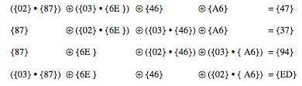
Mix Columns Example
Notes:
Show an example of the MixColumns transformation from the text, along with verification of the first column of this example.

Slide 48

Add Round Key
XOR state with 128-bits of the round key
again processed by column (though effectively a series of byte operations)
inverse for decryption identical
  since XOR own inverse, with reversed keys
designed to be as simple as possible
  a form of Vernam cipher on expanded key
  requires other stages for complexity / security
Notes:
Lastly is the Add Round Key stage which is a simple bitwise XOR of the current block with a portion of the expanded key. Note this is the only step which makes use of the key and obscures the result, hence MUST be used at start and end of each round, since otherwise could undo effect of other steps. But the other steps provide confusion/diffusion/non-linearity. That us you can look at the cipher as a series of XOR with key then scramble/permute block repeated. This is efficient and highly secure it is believed.

Slide 49

AES Round
(state formed by column-wise placing of elements )
Notes:
Can thus now view all the internal details of the AES round, showing how each byte of the state is manipulated, as shown in Stallings Figure 5.4.

Slide 50
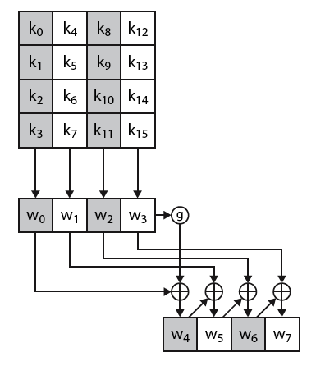
AES Key Expansion
takes 128-bit (16-byte) key and expands into array of 44/52/60 32-bit words
start by copying key into first 4 words
then loop creating words that depend on values in previous & 4 places back
  in 3 of 4 cases just XOR these together
  1st word in 4 has rotate + S-box + XOR round constant on previous, before XOR 4th back
w_{i}=w_{i-1} xor w_{i-4} | if i≠ multiple of 4
g = S-Box (LCS(w₃)) xor RoundConstant_{i}
Notes:
The AES key expansion algorithm takes as input a 4-word (16-byte) key and produces a linear array of words, providing a 4-word round key for the initial AddRoundKey stage and each of the 10/12/14 rounds of the cipher. It involves copying the key into the first group of 4 words, and then constructing subsequent groups of 4 based on the values of the previous & 4th back words. The first word in each group of 4 gets “special treatment” with rotate + S-box + XOR constant on the previous word before XOR’ing the one from 4 back. In the 256-bit key/14 round version, there’s also an extra step on the middle word. The text includes in section 5.4 pseudocode that describes the key expansion.

Slide 51
Key Expansion Rationale
designed to resist known attacks
design criteria included
  knowing part key insufficient to find many more
  ^{invertible transformation}
  ^{fast on wide range of CPU’s}
  use round constants to break symmetry
  diffuse key bits into round keys
  enough non-linearity to hinder analysis
  ^{simplicity of description}
Notes:
The Rijndael developers designed the expansion key algorithm to be resistant to known cryptanalytic attacks. It is designed to be simple to implement, but by using round constants break symmetries, and make it much harder to deduce other key bits if just some are known (but once have as many consecutive bits as are in key, can then easily recreate the full expansion). The design criteria used are listed above.

Slide 52
Other Symmetric Block Ciphers
International Data Encryption Algorithm (IDEA)
  128-bit key
  Used in PGP
Blowfish (A variant of DES with S-Box having values that are both random and key dependant)
  Easy to implement
  High execution speed
  Run in less than 5K of memory

Slide 53
Other Symmetric Block Ciphers
RC5
  Variable number of rounds
  Data-dependent rotations
  Variable-length key
  Suitable for hardware and software
  Fast, simple
  Adaptable to processors of different word lengths
  Low memory requirement
  High security
Cast-128
  Key size from 40 to 128 bits
  The round function differs from round to round

Slide 54
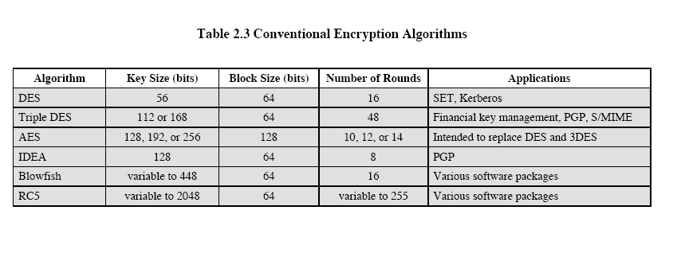

Slide 55
Cipher Block Modes of Operation

Slide 56
Encrypting a Large Massage
Electronic Code Book (ECB)
Cipher Block Chaining (CBC)
Output Feedback Mode (OFB)
Cipher Feedback Mode (CFB)
Counter Mode

Slide 57
Electronic Code Book (ECB)
Break the message into 64-bit blocks (padding the last one) and encrypt each block with the secret key.
Two problems:
two identical plain text block produce two identical cipher blocks
blocks can be rearranged or modified.
Example: An eavesdropper:
1. can see which sets of employees have identical or similar salaries and
2. he can alter his own salary to match another employee with higher salary.

Slide 58
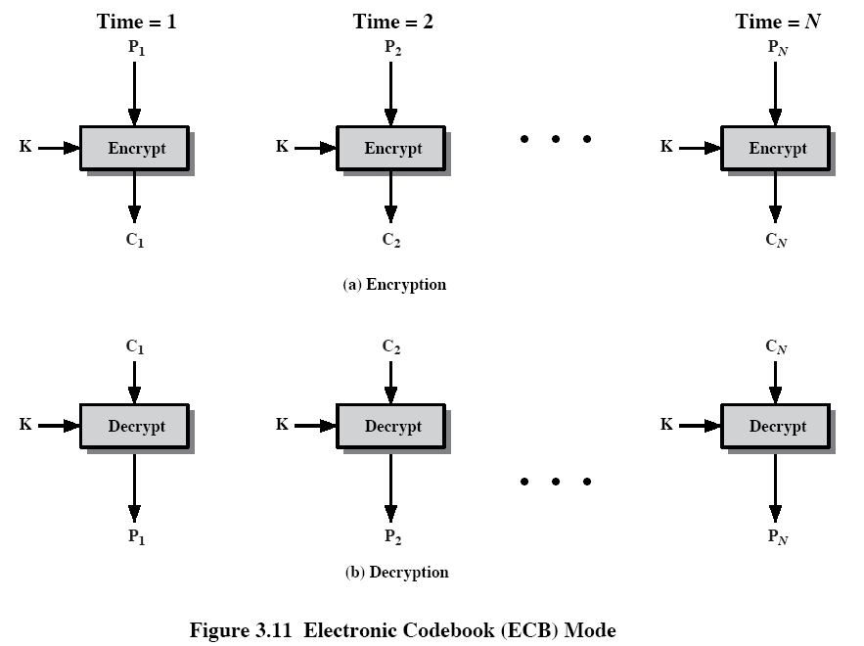

Slide 59
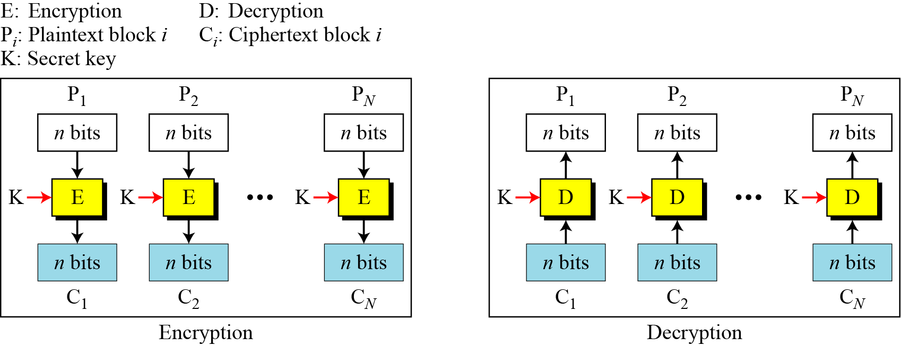
ECB Scheme
Notes:
Stallings Fig 3-11.

Slide 60
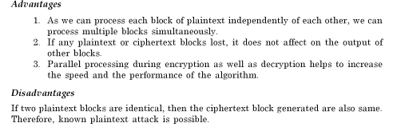
Remarks on ECB
Typical application:
  secure transmission of short pieces of information (e.g. a temporary encryption key)

Slide 61
Cipher Block Chaining (CBC)
Solve security deficiencies in ECB
  Repeated same plaintext block result different ciphertext block
Each previous cipher blocks is chained to be input with current plaintext block, hence name
Use Initialization (or Initial) Vector (IV) to start process
  C_{i} = E_{K} (P_{i} XOR C_{i-1})
  C₀ = IV
Uses: bulk data encryption, authentication
Notes:
To overcome the problems of repetitions and order independence in ECB, want some way of making the ciphertext dependent on all blocks before it. This is what CBC gives us, by combining the previous ciphertext block with the current message block before encrypting. To start the process, use an Initial Value (IV), which is usually well known (often all 0's), or otherwise is sent, ECB encrypted, just before starting CBC use. CBC mode is applicable whenever large amounts of data need to be sent securely, provided that its available in advance (eg email, FTP, web etc)

Slide 62
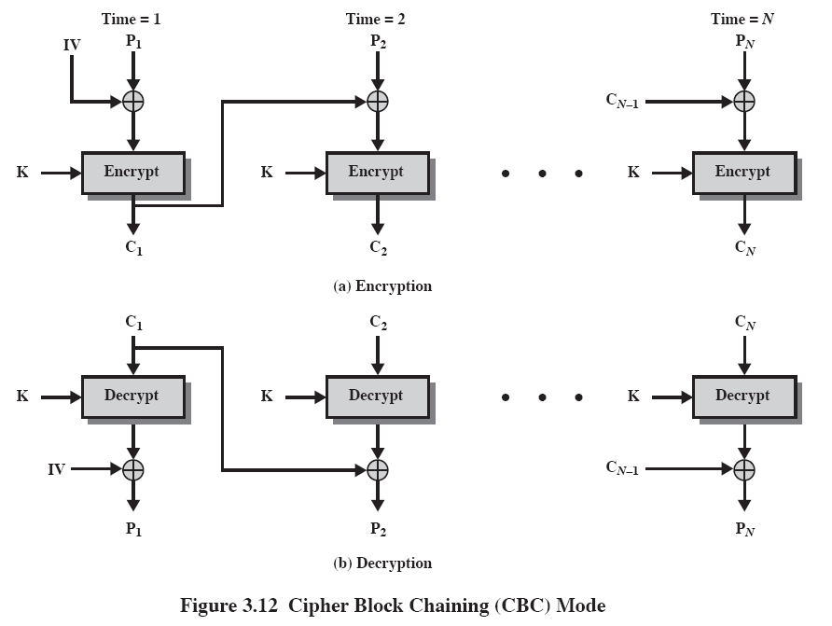

Slide 63
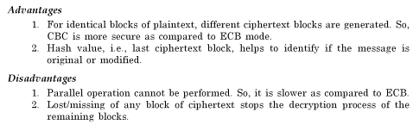
Remarks on CBC
Initialization Vector (IV)
  May sent encrypted in ECB mode before the rest of ciphertext

Slide 64
Cipher FeedBack (CFB)
Use Initial Vector to start process
Encrypt previous ciphertext , then combined with the plaintext block using X-OR to produce the current ciphertext
Cipher is fed back (hence name) to concatenate with the rest of IV
Plaintext is treated as a stream of bits
  Any number of bit (1, 8 or 64 or whatever) to be feed back (denoted CFB-1, CFB-8, CFB-64)
Relation between plaintext and ciphertext
  C_{i} = P_{i} XOR SelectLeft(E_{K} (ShiftLeft(C_{i-1})))
  C₀ = IV
Uses: stream data encryption, authentication
Notes:
If the data is only available a bit/byte at a time (eg. terminal session, sensor value etc), then must use some other approach to encrypting it, so as not to delay the info. Idea here is to use the block cipher essentially as a pseudo-random number generator (see stream cipher lecture later) and to combine these "random" bits with the message. Note as mentioned before, XOR is an easily inverted operator (just XOR with same thing again to undo). Again start with an IV to get things going, then use the ciphertext as the next input. As originally defined, idea was to "consume" as much of the "random" output as needed for each message unit (bit/byte) before "bumping" bits out of the buffer and re-encrypting. This is wasteful though, and slows the encryption down as more encryptions are needed. An alternate way to think of it is to generate a block of "random" bits, consume them as message bits/bytes arrive, and when they're used up, only then feed a full block of ciphertext back. This is CFB-64 mode, the most efficient. This is the usual choice for quantities of stream oriented data, and for authentication use.

Slide 65
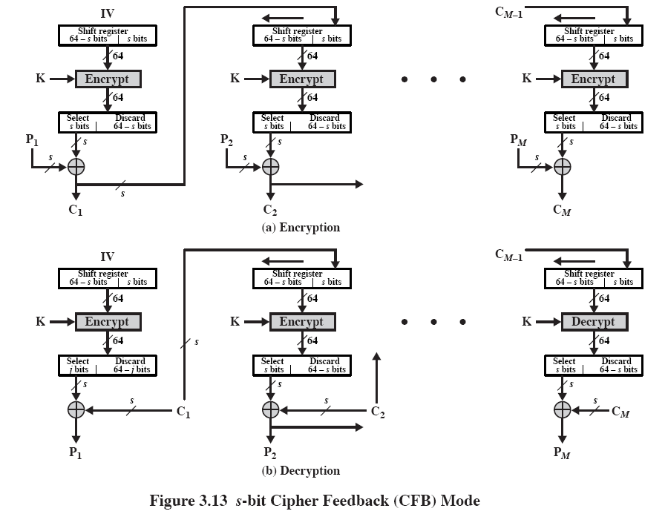

Slide 66
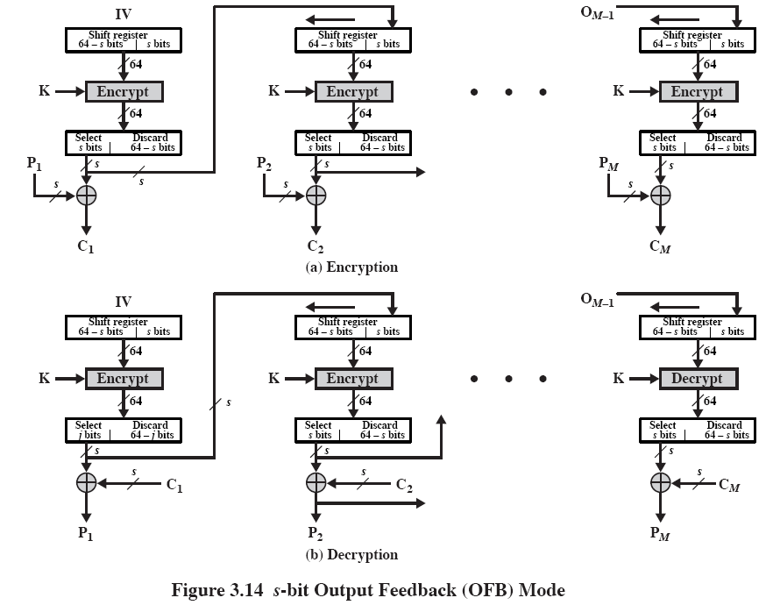

Slide 67
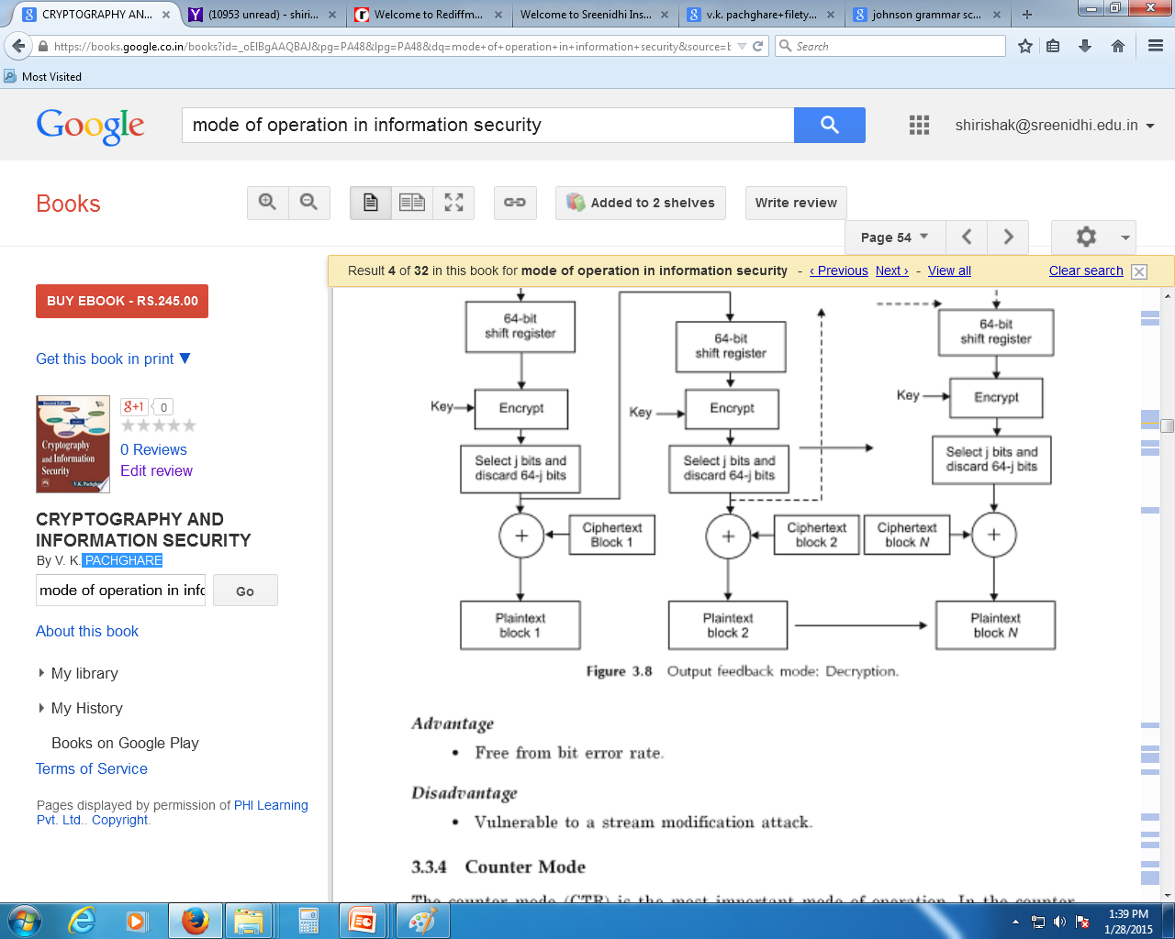
Remarks on Feedback Mode

Slide 68
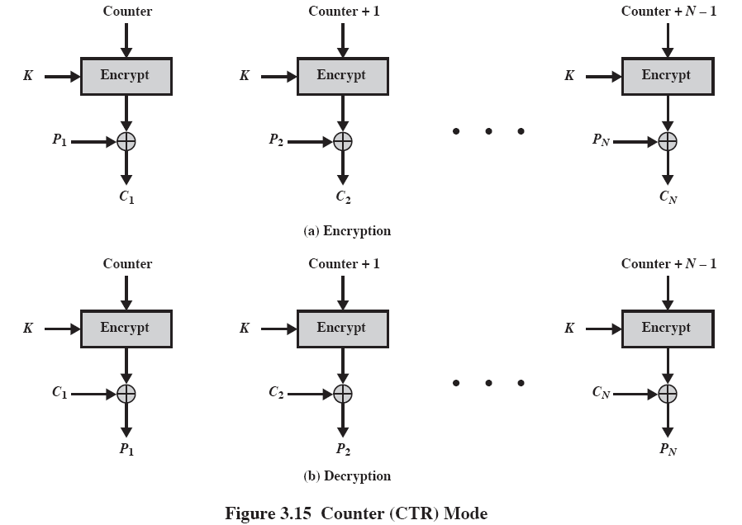

Slide 69
Location of Encryption Devices
Link encryption:
  A lot of encryption devices
  High level of security
  Decrypt each packet at every switch
End-to-end encryption
  The source encrypt and the receiver decrypts
  Payload encrypted
  Header in the clear
High Security: Both link and end-to-end encryption are needed (see Figure 2.9)

Slide 70
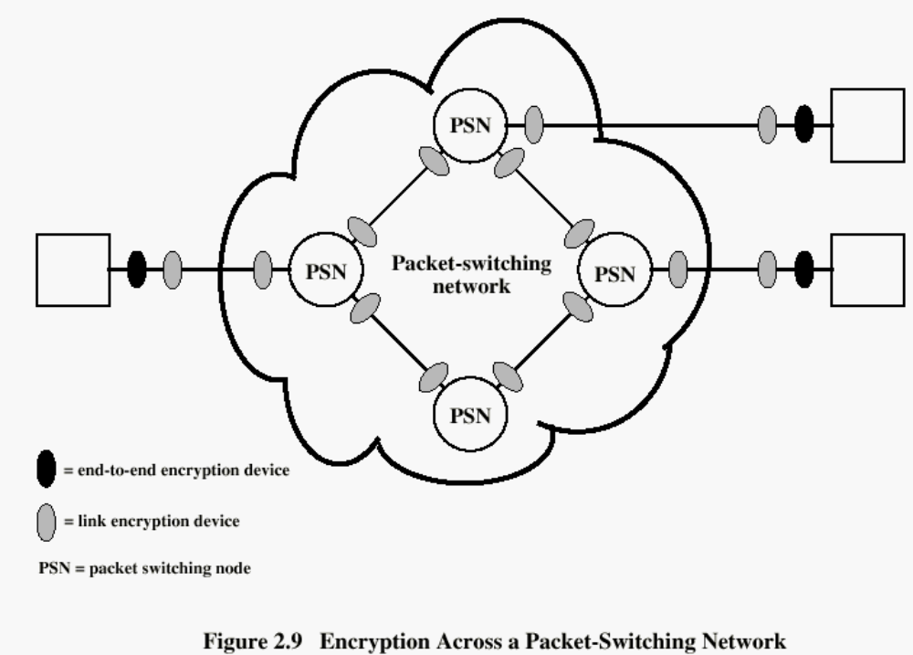

Slide 71
Key Distribution
A key could be selected by A and physically delivered to B.
A third party could select the key and physically deliver it to A and B.
If A and B have previously used a key, one party could transmit the new key to the other, encrypted using the old key.
If A and B each have an encrypted connection to a third party C, C could deliver a key on the encrypted links to A and B.

Slide 72
Key Distribution (See Figure 2.10)
Session key:
  Data encrypted with a one-time session key.At the conclusion of the session the key is destroyed
Permanent key:
  Used between entities for the purpose of distributing session keys

Slide 73
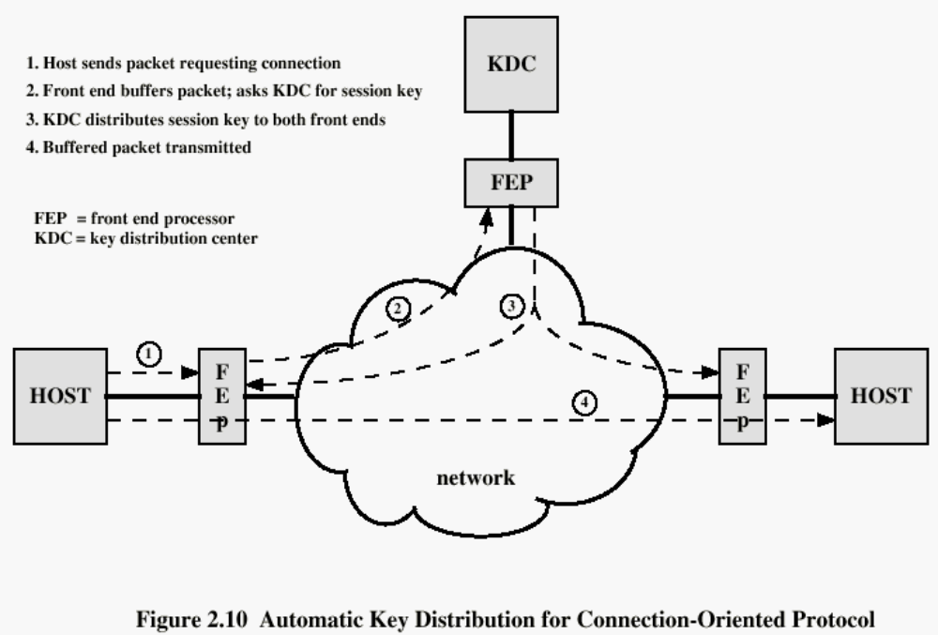

Slide 74
Authentication
Requirements - must be able to verify that:
1. Message came from apparent source or author,
2. Contents have not been altered,
3. Sometimes, it was sent at a certain time or sequence.
Protection against active attack (falsification of data and transactions)

Slide 75
Approaches to Message Authentication
Authentication Using Conventional Encryption
  Only the sender and receiver should share a key.
  Message with an error-detection code and a sequence no, timestamp.
Message Authentication without Message Encryption
-Message Authentication Code
  -One-Way hash function

Slide 76
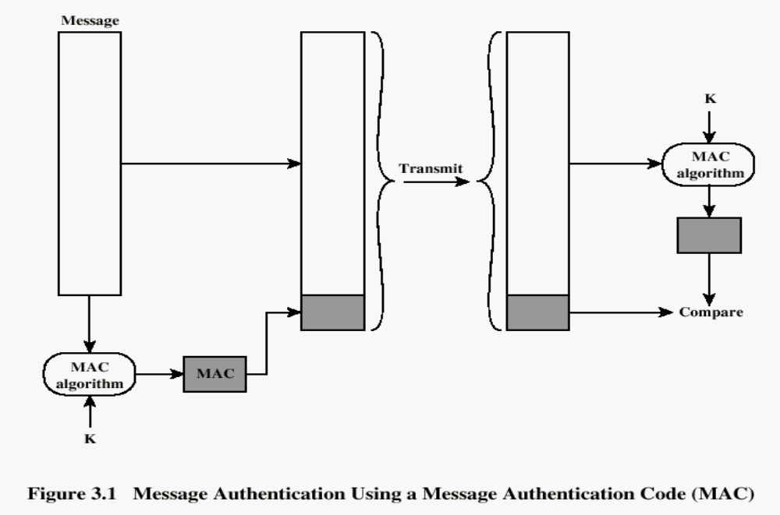
2. Message Authentication without Message Encryption -Message Authentication Code
_{MACM=F(KAB,M)}

Slide 77
If received code matches the calculated code, then:
The receiver is assured that the message has not altered.
The receiver is assured that the message is from the alleged sender.
If the message includes a sequence number, then the receiver can be assured of the proper sequence, because an attacker cannot successfully alter the sequence number.

Slide 78
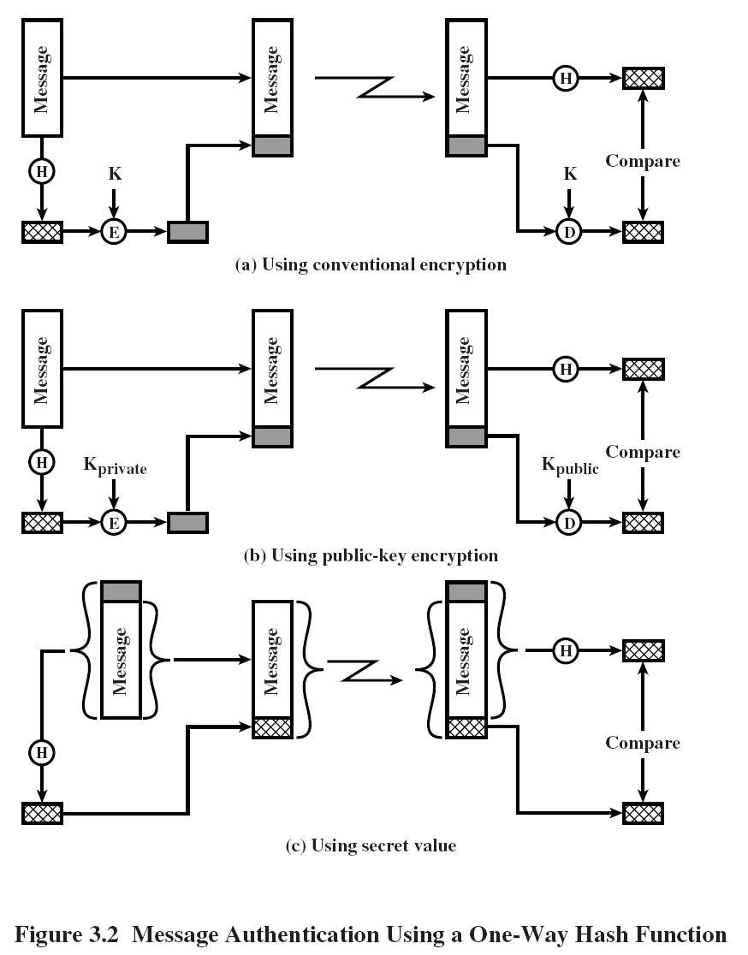
2. Message Authentication without Message Encryption
-One-Way hash function

Slide 79

Secure HASH Functions
Purpose of the HASH function is to produce a ”fingerprint.
Properties of a HASH function H :
  H can be applied to a block of data of any size
  H produces a fixed length output
  H(x) is easy to compute for any given x.
  For any given code h, it is computationally infeasible to find x such that H(x) = h
  For any given block x, it is computationally infeasible to find with H(y) = H(x).
  It is computationally infeasible to find any pair (x, y) such that H(x) = H(y)

Slide 80
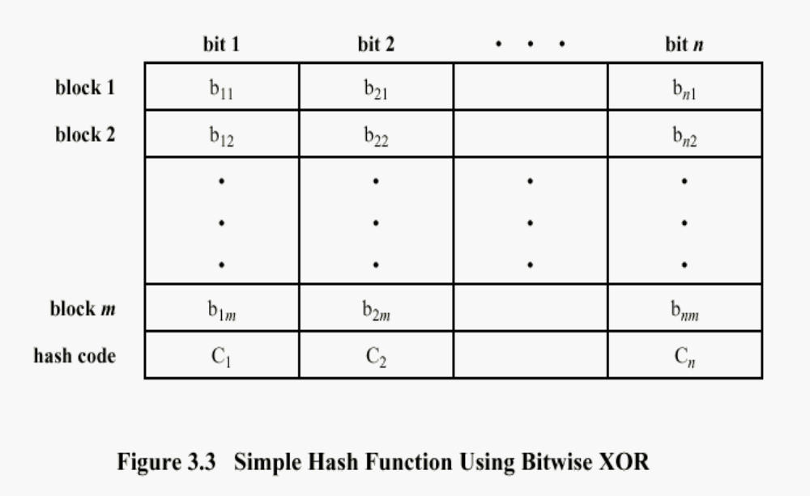
Simple Hash Function
b₁₁ xor b₁₂ xor …..xor b_{1m}

Slide 81
SHA-1
The algorithm takes as input a message with a maximum length of less than 2^64 bits and produces as output a 160-bit message digest.
The input is processed in 512-bit blocks.
Steps
pad message so its length is 448 mod 512
append a 64-bit length value to message
initialise 5-word (160-bit) buffer (A,B,C,D,E) to
  (67452301,efcdab89,98badcfe,10325476,c3d2e1f0)
process message in 16-word (512-bit) blocks:
  expand 16 words into 80 words by mixing & shifting
  use 4 rounds of 20 bit operations on message block & buffer
  add output to input to form new buffer value
output hash value is the final buffer value

Slide 82
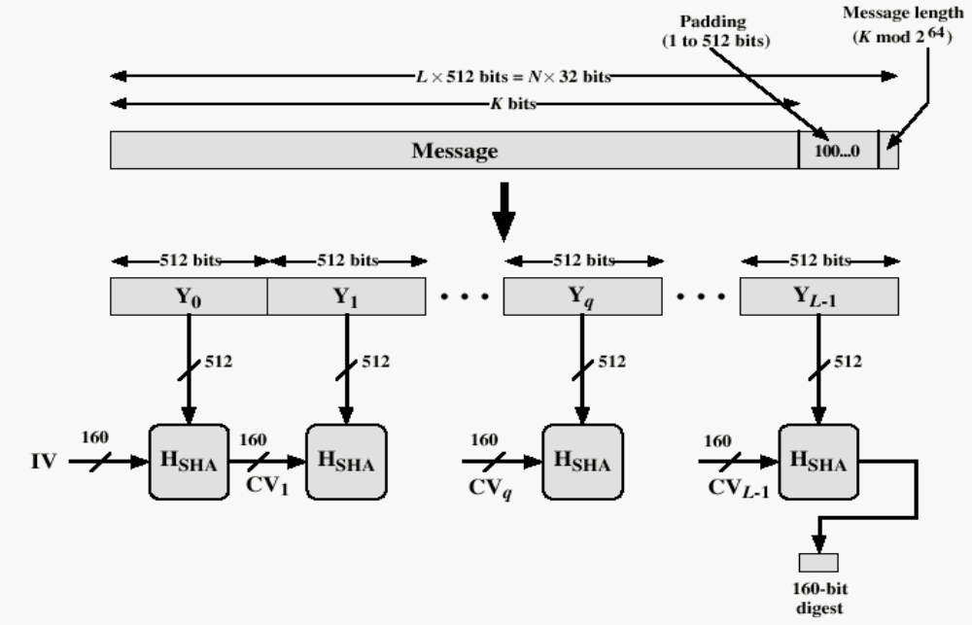
Message Digest Generation Using
Secure Hash Algorithm – 1 (SHA-1)

Slide 83
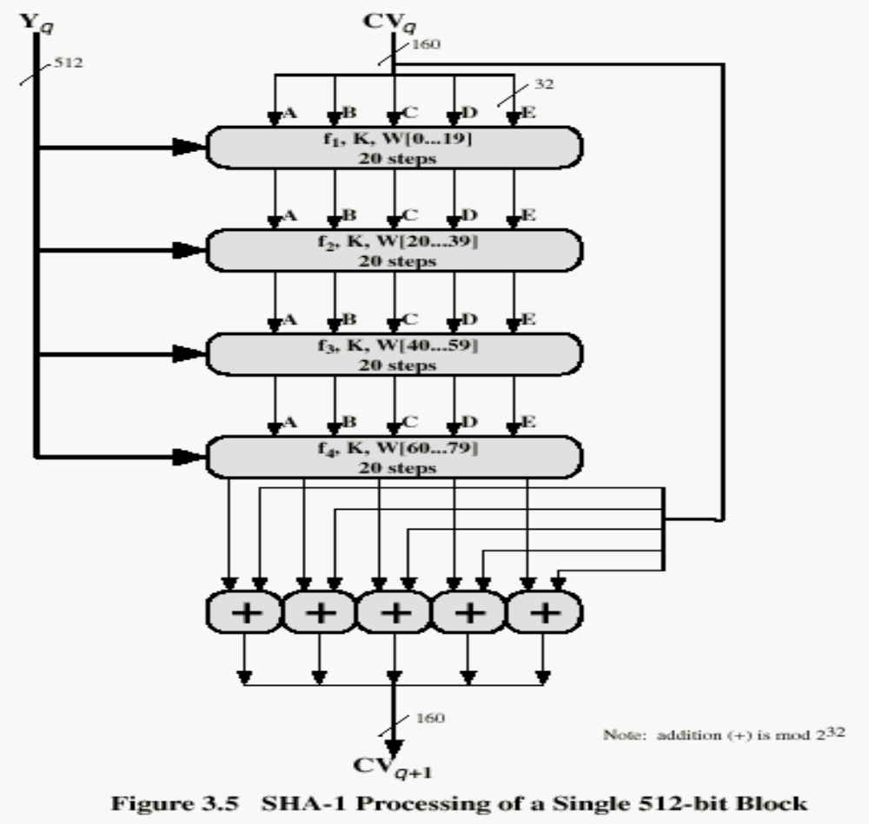
SHA-1 Processing of single 512-Bit Block

Slide 84
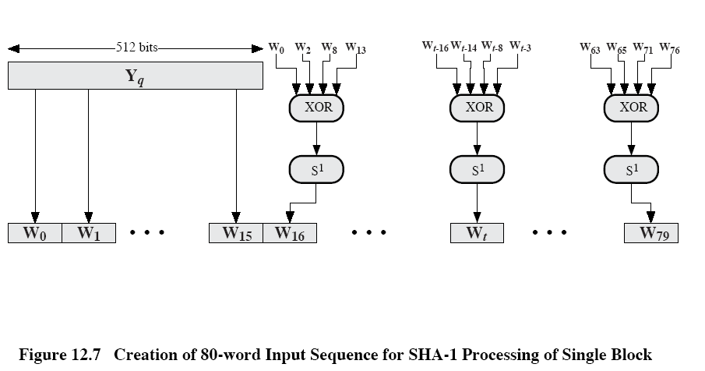

Slide 85
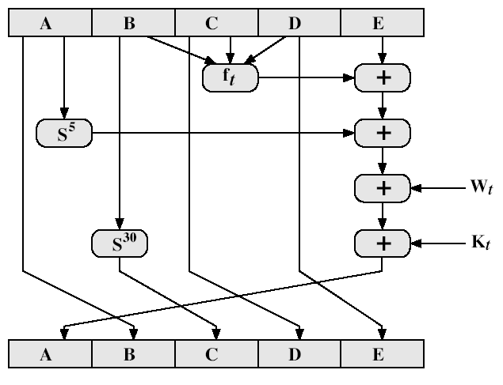
SHA-1 Compression Function

Slide 86
SHA-1 Compression Function
each round has 20 steps which replaces the 5 buffer words thus:
  (A,B,C,D,E) <-(E+f(t,B,C,D)+S5(A)+W_{t}^{+K}_{t}^{),A,S30(B),C,D}
a,b,c,d refer to the 4 words of the buffer
t is the step number
f(t,B,C,D) is nonlinear function for round
W_{t} is derived from the message block
K^{t is an additive constant}
+ addition modulo 2³²

Slide 87
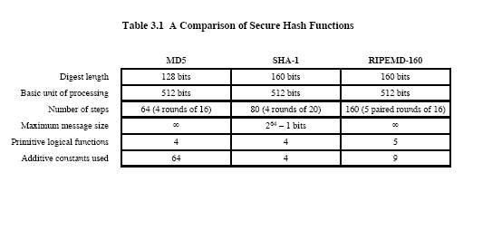
Other Secure HASH functions

Slide 88
HMAC
Use a MAC derived from a cryptographic hash code, such as SHA-1.
Motivations:
  Cryptographic hash functions executes faster in software than encryptoin algorithms such as DES
  Library code for cryptographic hash functions is widely available
  No export restrictions from the US
A cryptographic hash function: hash function which takes an input (or 'message') and returns a fixed-size alphanumeric string, which is called the hash value (sometimes called a message digest, a digital fingerprint, a digest or a checksum).

Slide 89
HMAC Design Objectives
To use without modifications, available hash functions-in particular, hash functions that perform well in software, and for which code is freely and widely available.
To allow for easy replaceability of the embedded hash functions in case faster or more secure hash functions are found or required.
To preserve the original performance of the hash functions without incurring a significant degradation.
To use and handle keys in a simple way.
To have a well understood cryptographic analysis of the strength of the authentication mechanism based on reasonable assumptions about embedded hash function.

Slide 90
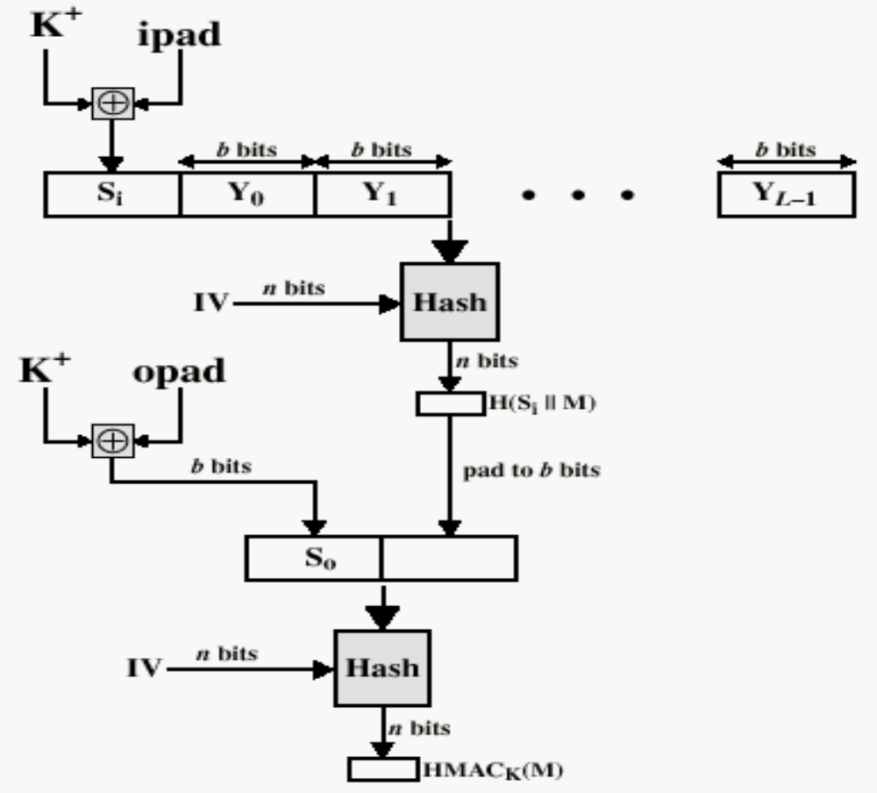
HMAC Structure

Slide 91
H = embedded hash function (e.g., SHA-1)
IV= initial value input to hash function
M = message input to HMAC (including the padding specified in the embedded hash function)
Y_{i} = i th block of M, 0 ≤ i ≤ (L-1)
L = number of blocks in M
b = number of bits in a block
n = length of hash code produced by embedded hash function
K = secret key; if key>b;the key is input to hash fun to produce an n-bit key:recommended length is >=n.
K+ = K padded with zeros on the left so that the result is b bits in length
ipad = 00110110 (36 in hexadecimal) repeated b/8 times
opad = 01011100 (5C in hexadecimal) repeated b/8 times
Then HMAC can be expressed as follows:
HMAC_{k} = H[(K+ opad) || H[(K+ ipad) || M]]

Slide 92
HMAC Algorithm
1.Append zeros to the left end of K to create a b-bit string K+ (e.g., if K is of length 160 bits and b=512, then K will be appended with 44 zero bytes 0x00).
2.XOR K+ with ipad to produce the b-bit block s_{i}
3.Append M to s_{i}
4.Apply H to the stream generated in step3
5.XOR K+ with opad to produce the b-bit block s₀
6.Append the hash result from step4 to s₀
7.Apply H to the stream generated in step6 and output the result.

